Slide 1
Tips When Doing CAD Collaboration
李岱峰，17机器人工程
2020.07.22

Slide 2
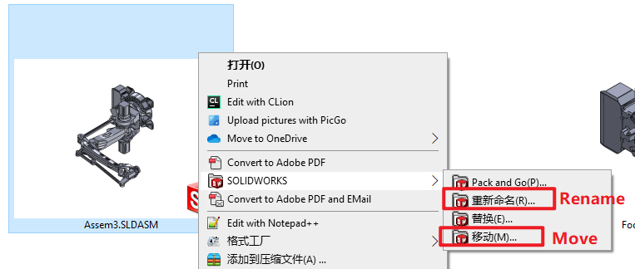
Change File Name or Move the File
Do it in this way, otherwise you will lose the reference/connection with other files.

Slide 3
Sketches
Fully define sketches. All BLACK, no BLUE.
DO NOT use “Fully Define Sketch” button
Use equations, relations, and general variables
Use relation definitions (for example, “=”), or define variables
Dimension rectangles from the edges, not the corner
Make separate features in separate sketch unless it’s master sketch from top-down
Use symmetrical relations
Put origin at a mounting location (or center point)
Use construction lines to help define sketch (less unnecessary trim）
3D Sketch - 2D first then having 3D sketch come off of that

Slide 4
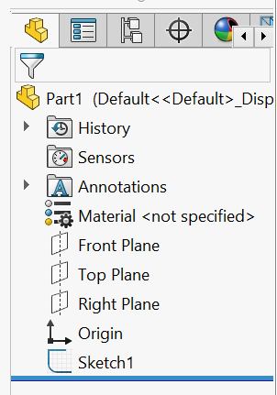
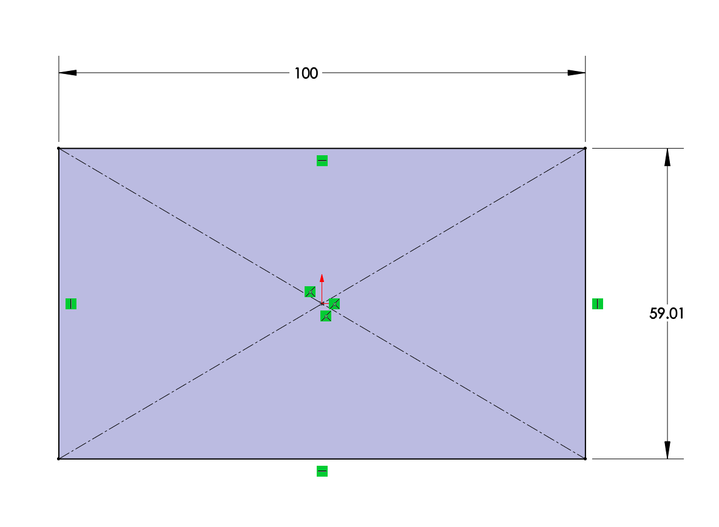
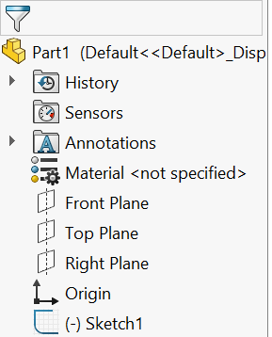
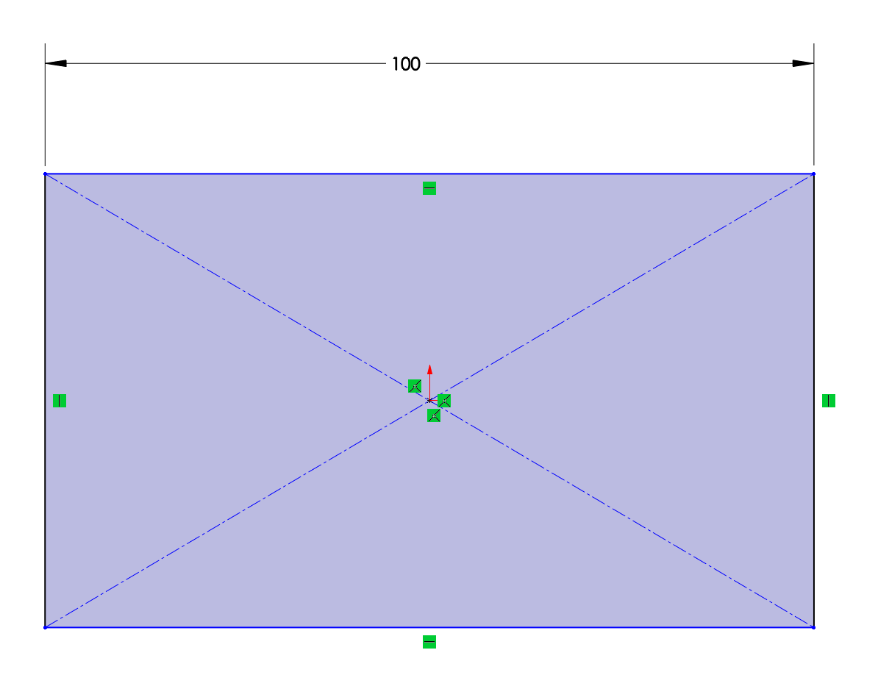
Sketch - Fully Define Sketches

Slide 5
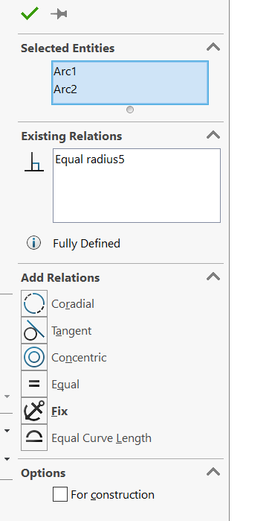
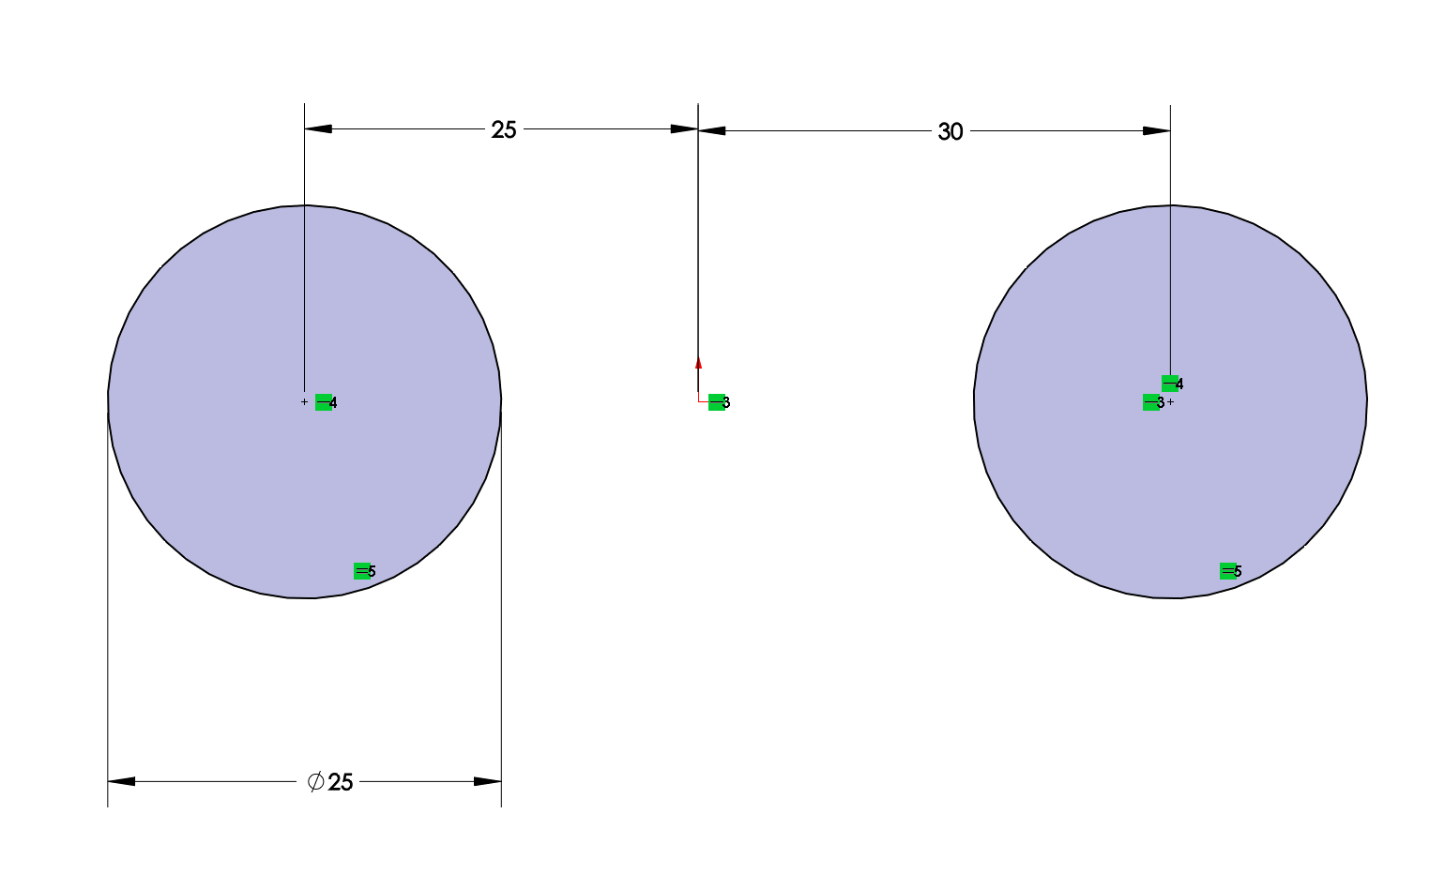
Sketch - Combine Common Dimensions

Slide 6
Sketch - Dimensioning Rectangles
Demonstration
Notes:
Example of why, what’s gonna happen if not

Slide 7
Use Construction Lines
Also:
-Symmetrical Relation
-Origin

Slide 8
Parts
Use symmetry whenever possible
Use configuration when possible
Make features like when it’s being machined
Name useful dimensions and features
Especially when those dimensions are referenced
Make several simple features instead of one complicated feature. (More robust and easy to edit)
Use fillet features instead of sketch fillets
Apply cosmetic fillet and chamfer last

Slide 9
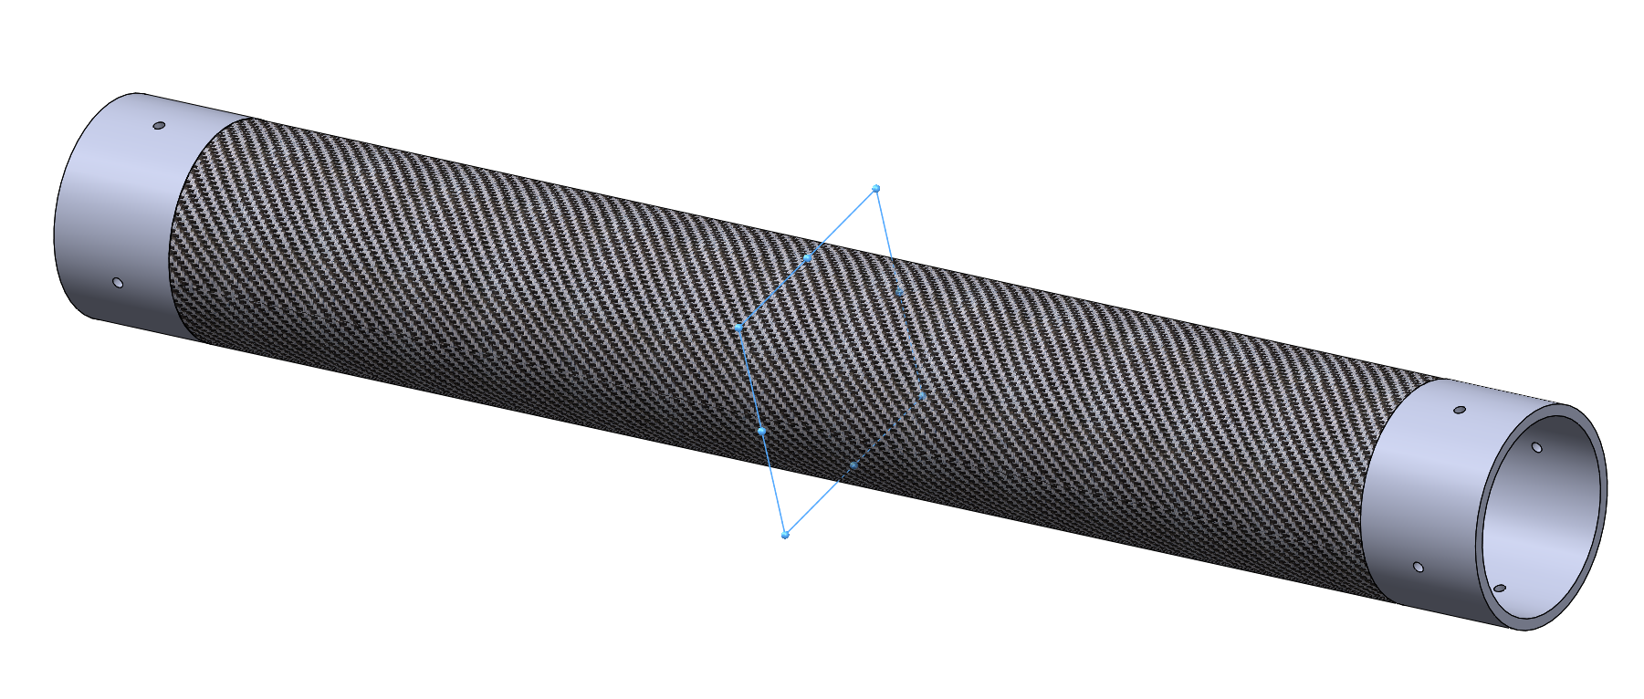
Use Symmetrical Relations

Slide 10
Use Configuration
Demonstration
Notes:
有可变参数的时候

Slide 11
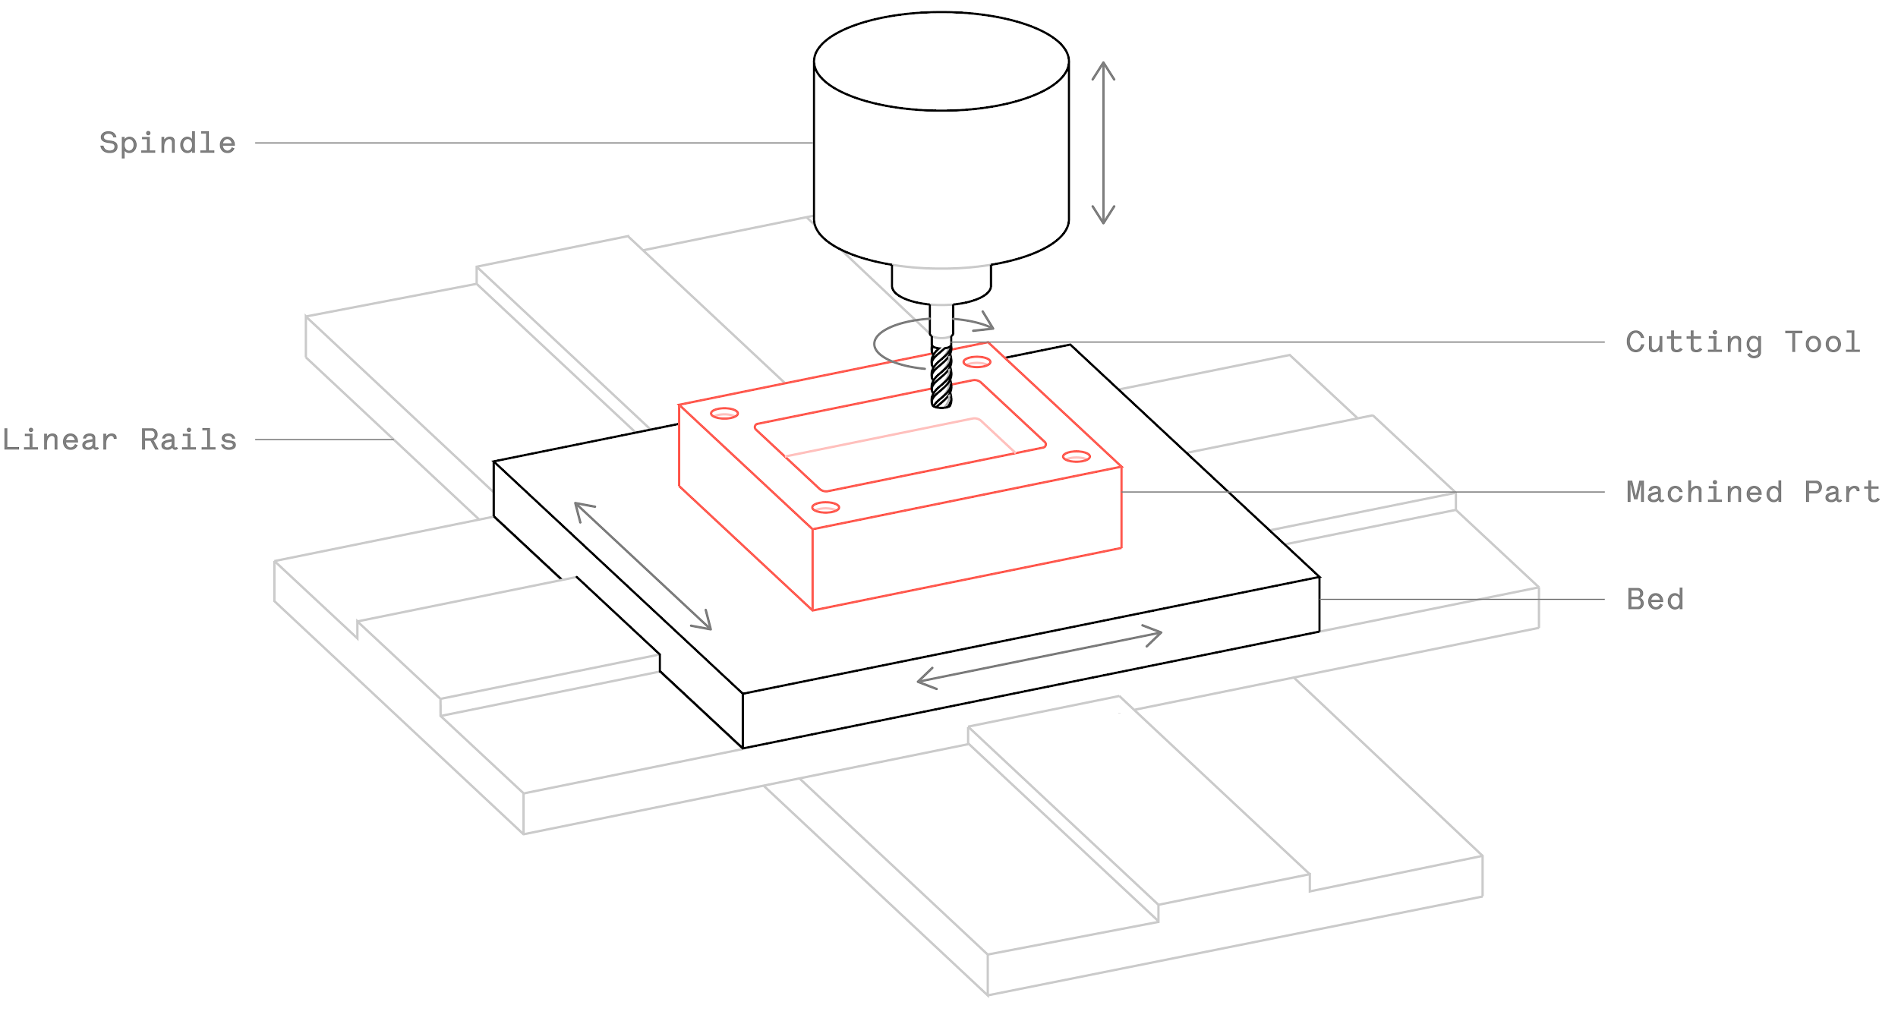
Make features Like Being Machined（not necessary for you now）
Even better, if you dimension it as being machined
Notes:
比如，这个方块的槽数值edge不能是sharpe的

Slide 12
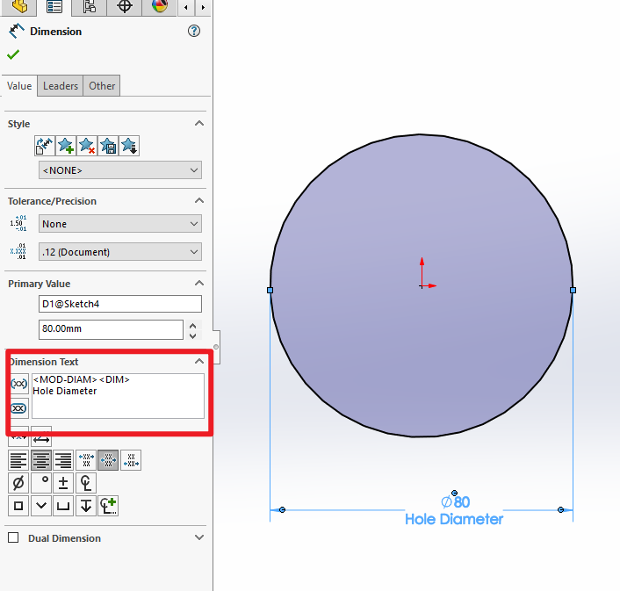
Label Important Dimensions

Slide 13
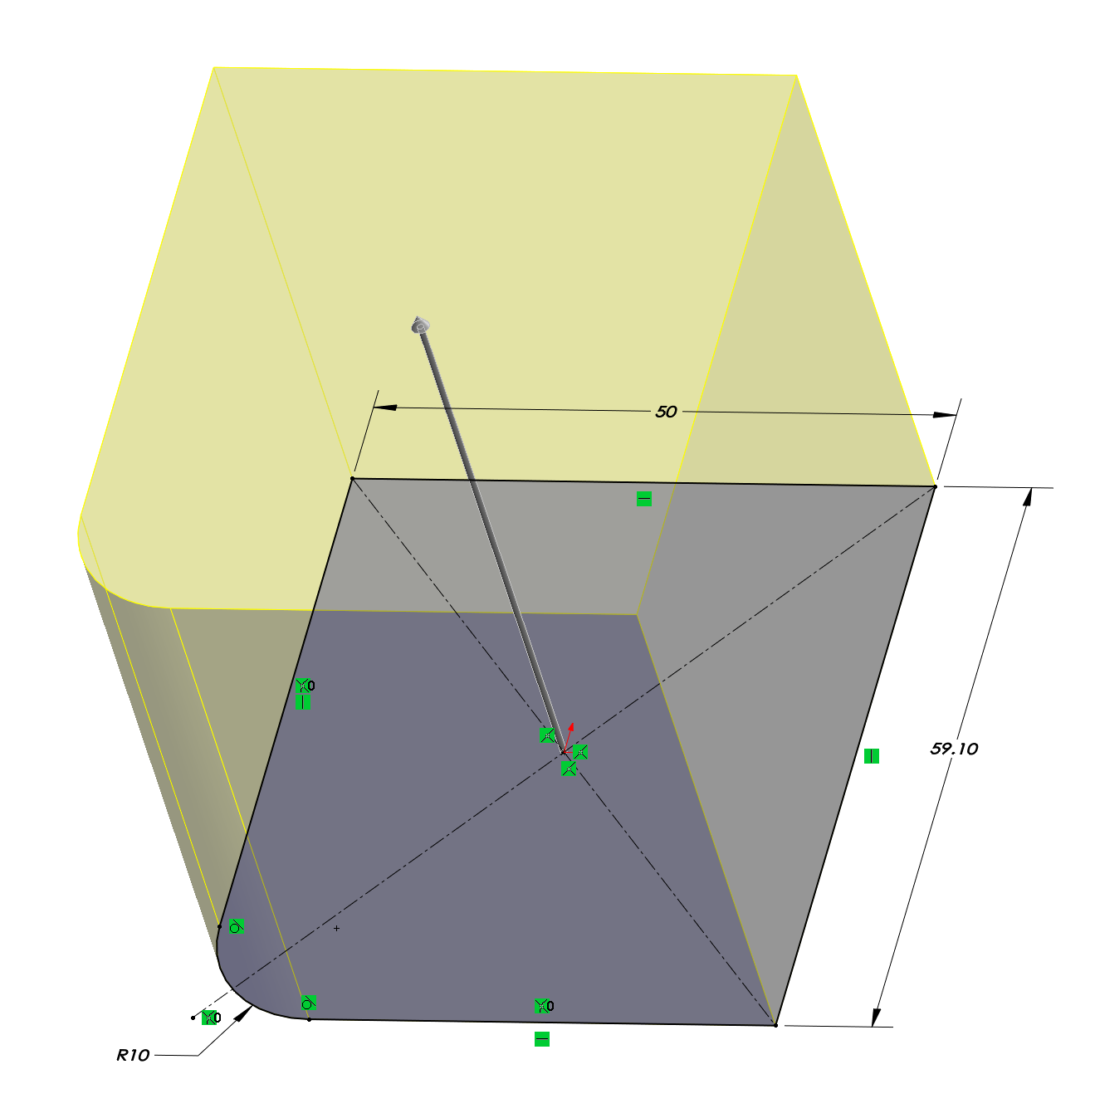
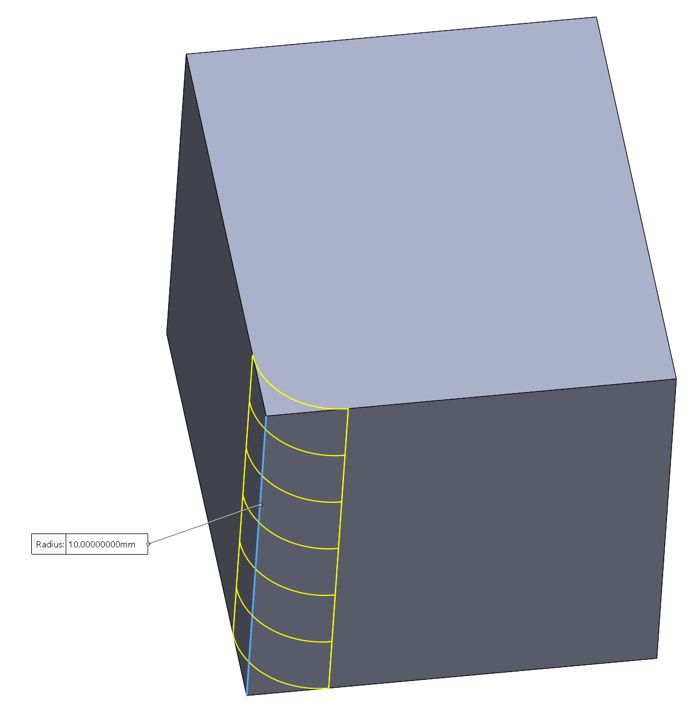
Fillet in Feature Not Sketch if Possible

Slide 14
Use Component Patterns
Demonstration

Slide 15
Assembly
Origin plane mates (especially first part)
If possible, mate all components to one or two fixed references
Long chains of components take longer to solve and more likely to get errors.
Do not create loops for mates
Fully define the position of each part in assembly, unless visualization of motion needed for certain parts
Option: use mechanical mates
Patterns, not multiple same parts if possible (greatly reduce computing power needed)
Lock rotation on cylindrical mate if you don't need rotation

Slide 16
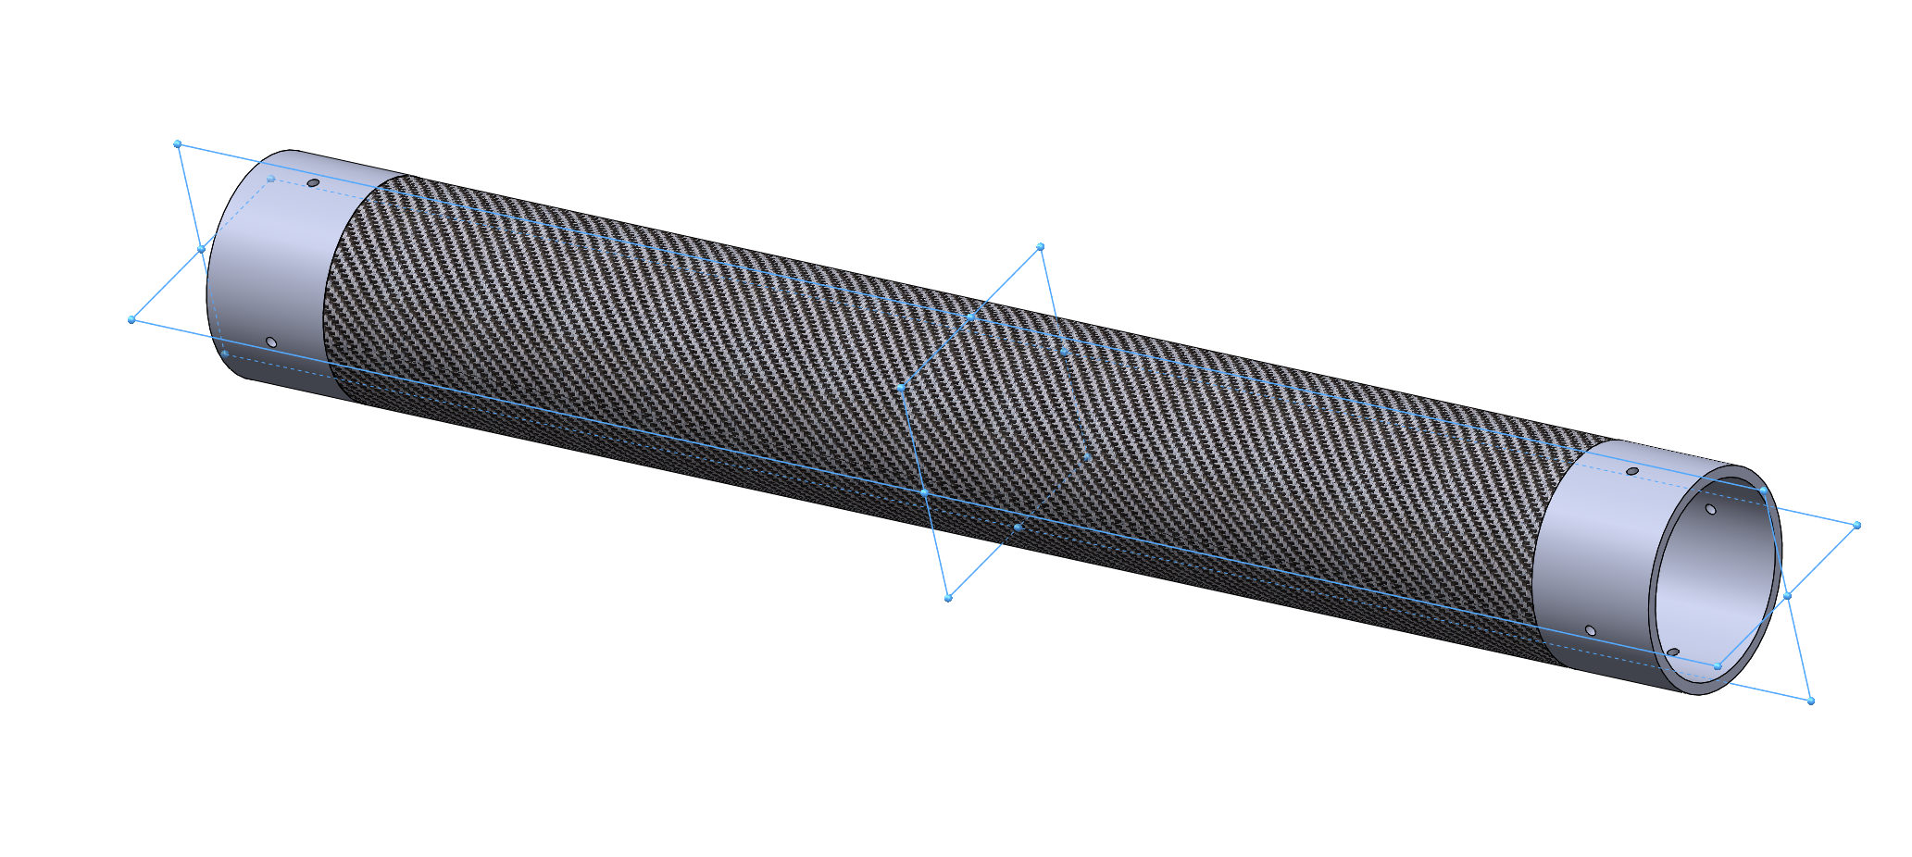
Put Origin as Mount Location
Notes:
Float first, and re-mate it

Slide 17
Small trick for assembling: Copy with mates
Demonstration

Slide 18
Reference
http://help.solidworks.com/2018/English/SolidWorks/sldworks/c_Best_Practices_for_Mates_SWassy.htm?verRedirect=1
https://blog.alignex.com/10-large-assembly-best-practices-in-solidworks
https://forum.solidworks.com/thread/183132
https://petercad.com/category/solidworks-best-practices/
https://www.solidsolutions.co.uk/solidworks/tutorial-videos/top-down-modelling-best-practice.aspx

